Slide 1
Industry Affairs
Fire Life Safety Codes
ILLINOIS FIRE INSPECTORS ASSOC
siemens.tld/keyword
Restricted © Siemens AG 20XX

Slide 2

Contents
  Introduction 4
  Review of New UL Smoke Detection Changes 3
  IL Smoke Alarm Changes 8
  520 Hz Notification Updates 11
  Questions and Answers 47

Slide 3
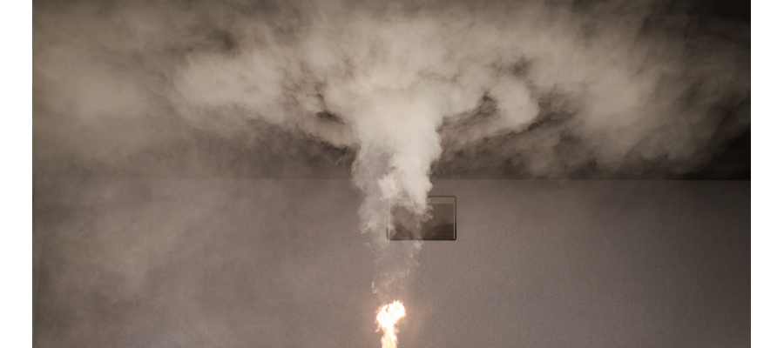
UL-Changes to Smoke Detectors and Smoke Alarms
Restricted © Siemens AG 20XX
XX.XX.20XX
Page 3
Author / Department

Slide 4
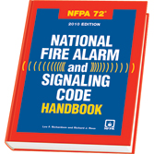
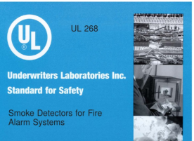
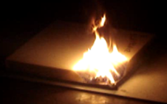
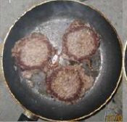
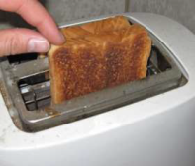
Summary of new UL268 Smoke Detector Changes
Biggest Change to UL Test Standards for Smoke Detectors in the 25 + years!
  New UL268 7th Edition test standard (published in July 2016)
  Includes new PU Foam & Nuisance Alarm Resistance test
  Shift from Natural materials to Synthetic material used in hotels, dorms, homes etc.
  Egress (escape) time was 17 mins. in 1970, now 3 mins.
  Reduce Nuisance Alarms caused by cooking.
Major technology challenge; detectors more sensitive & less susceptible to false alarms
Mandatory compliance date is by May 29, 2020
No smoke detectors are available now that are listed to the new UL268 standard
+
+

Slide 5

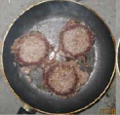
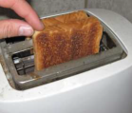
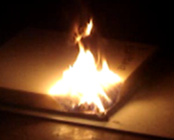
UL Smoke Photo-Electric Detector Sensitivity Range (Window )
Today
0.5%/Ft
4%/Ft
Production Window spans 3.5%/FT
2.5%
Major compression of Sensitivity Window 70%
Detectors are less Sensitive (Nuisance Resistance)
Detectors are less Robust (respond sooner to Flaming & Smoldering Synthetic Material)
UL 268 7th Edition Preparation
  PU Foam Tests
  Nuisance Alarm Resistance
Production Window spans 1.3%/FT
May 29, 2020
Single sensor technology challenged
Ionization won’t pass
Intelligent Detectors
Multi-Sensor dominate Market
1.5%/Ft
2.8%/Ft
2.0%

Slide 6
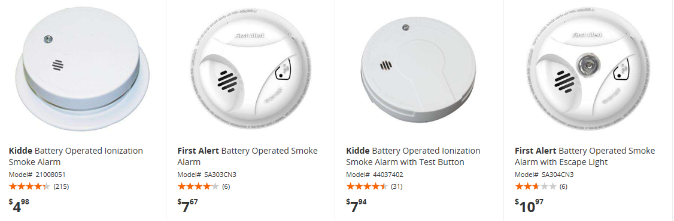

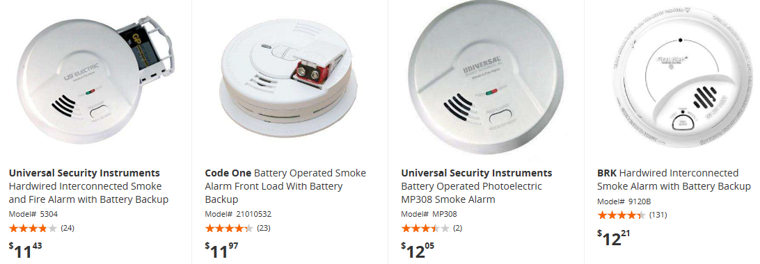

Household Smoke Alarms – Big Changes
Ionization Detectors
Photo-Electric Detectors

Slide 7
What does this UL change mean?
Legacy Smoke Detectors will not meet the New UL268 test standard
  Phase Out Announcements already published for Ionization, HFP-11 & FP-11 detectors
  Component Obsolescence
  Grandfather clause for installed systems (not required to replace old detectors)
  Siemens can not build & UL label non complaint detectors after May 29, 2020
Siemens detectors will be updated to meet the new UL268 requirements
Siemens detectors that meet the new UL268 standard;
  Will be Backward Compatible with XLS, Diesgo panels.
  Can mix and match HFP-11, Desigo (built prior to May 2020) and New UL268 compliant
  detectors on the same XLS (DLC) or Cerberus PRO panels.
  MXL (FP-11) detectors will not be Manufactured after May 29, 2020.

Slide 8
ILLINOIS SMOKE ALARM CHANGES
“More than half of fire-related deaths
occur in homes
with no smoke alarm or no working smoke alarm.

Slide 9
State updates smoke detectors law
In conjunction with the Fire Prevention Month, fire, safety and public health officials joined forces to make the public aware of Illinois' new 10-year smoke detector law. "In 2017, there were 114 residential fire deaths in Illinois and sadly already 98 fatalities so far in 2018," said Illinois Fire Safety Alliance and Illinois Firefighters Association Government Affairs Director Margaret Vaughn in a press release. "Nearly 70 percent of these deaths are occurring in homes without working smoke detectors. In order to address this horrific problem, the General Assembly passed 100-200, which requires Illinois residents to replace their old smoke detectors with the type that has a long term 10-year sealed battery by the end of 2022. This would apply to residents that are still using alarms with removable batteries or alarms that are not hardwired." Since 1988, the Illinois Smoke Detector Act has required all dwellings to have smoke detectors, the new requirement just updates that law to reflect the changes in new technology, aimed at saving lives, while making it easier and more cost effective for Illinois residents to comply.

Slide 10
it includes the following exceptions, so that wireless devices are exempt.

Slide 11
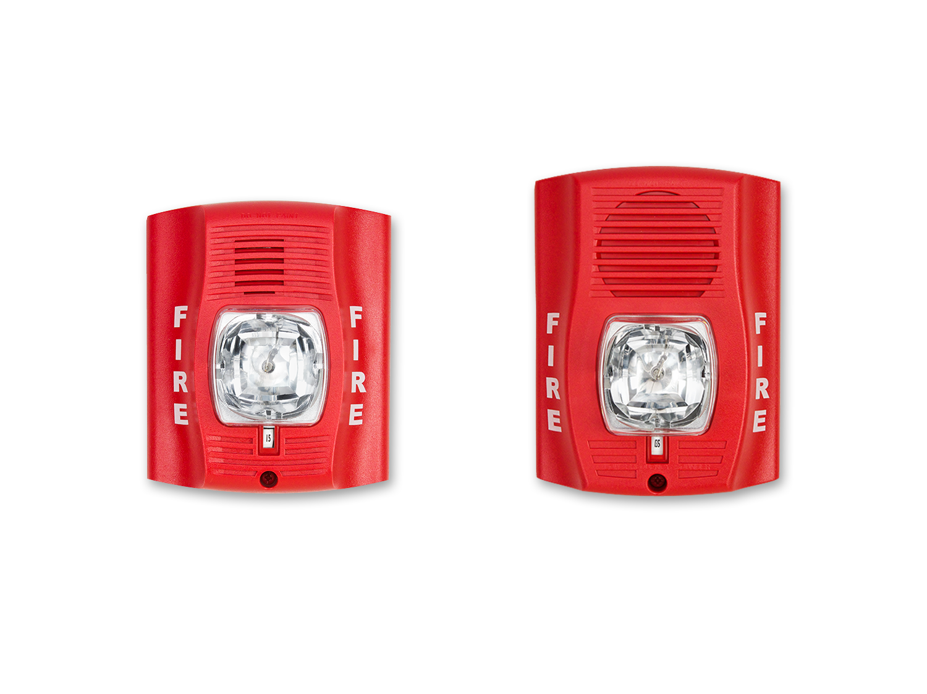
520 Hz Updates
  The low frequency signal with a
  fundamental frequency of 520 Hz
  is the most effective signal
  for awakening people who are hard of hearing

Slide 12
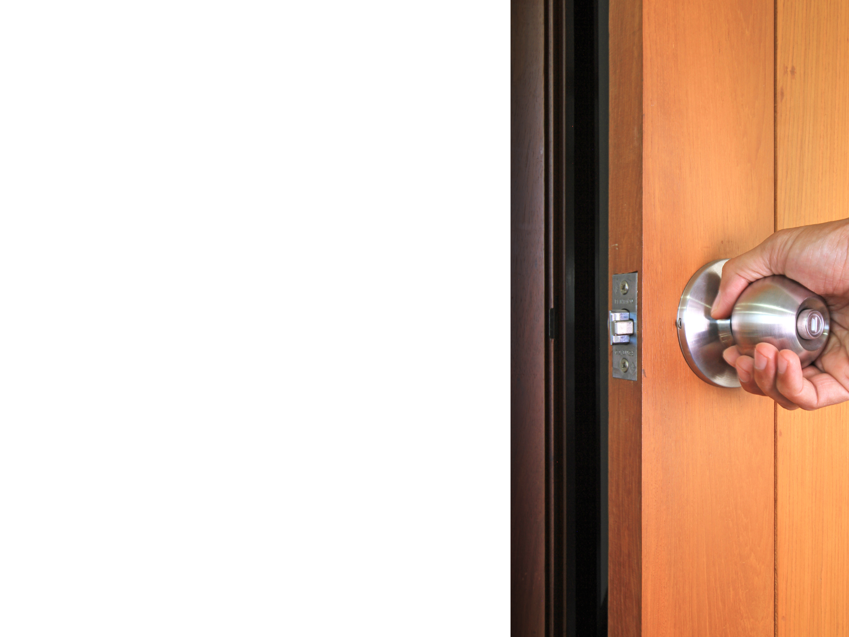
Challenging Factors
Factors that limit an occupant’s ability to safely exit the dwelling or building during a fire:
  Escape Time
    Required Safe Egress Time (RSET)
    Available Safe Egress Time (ASET)
  Waking effectiveness of the audible alarm signal in high-risk groups

Slide 13

Decreased Escape Times
Dwellings and buildings today have increased in size and contain more synthetic materials
  Average square footage of new single-family dwellings:
    1973: 1,660 ft²
    2008: 26% of new homes were greater than 3,000 ft²
    2010: 2,392 ft²
    Construction methods changed from using real wood lumber to engineered lumber

Slide 14

Decreased Escape Times
Furnishing manufacturers in the last 30 years have replaced natural fibers with lower-cost, man-made synthetic materials
  Natural materials: Legacy furnishings used wood, cotton batting, linen, and silk
  Synthetic materials: Modern furnishings utilize polyurethane foam for padding and synthetic fabrics for covers

Slide 15
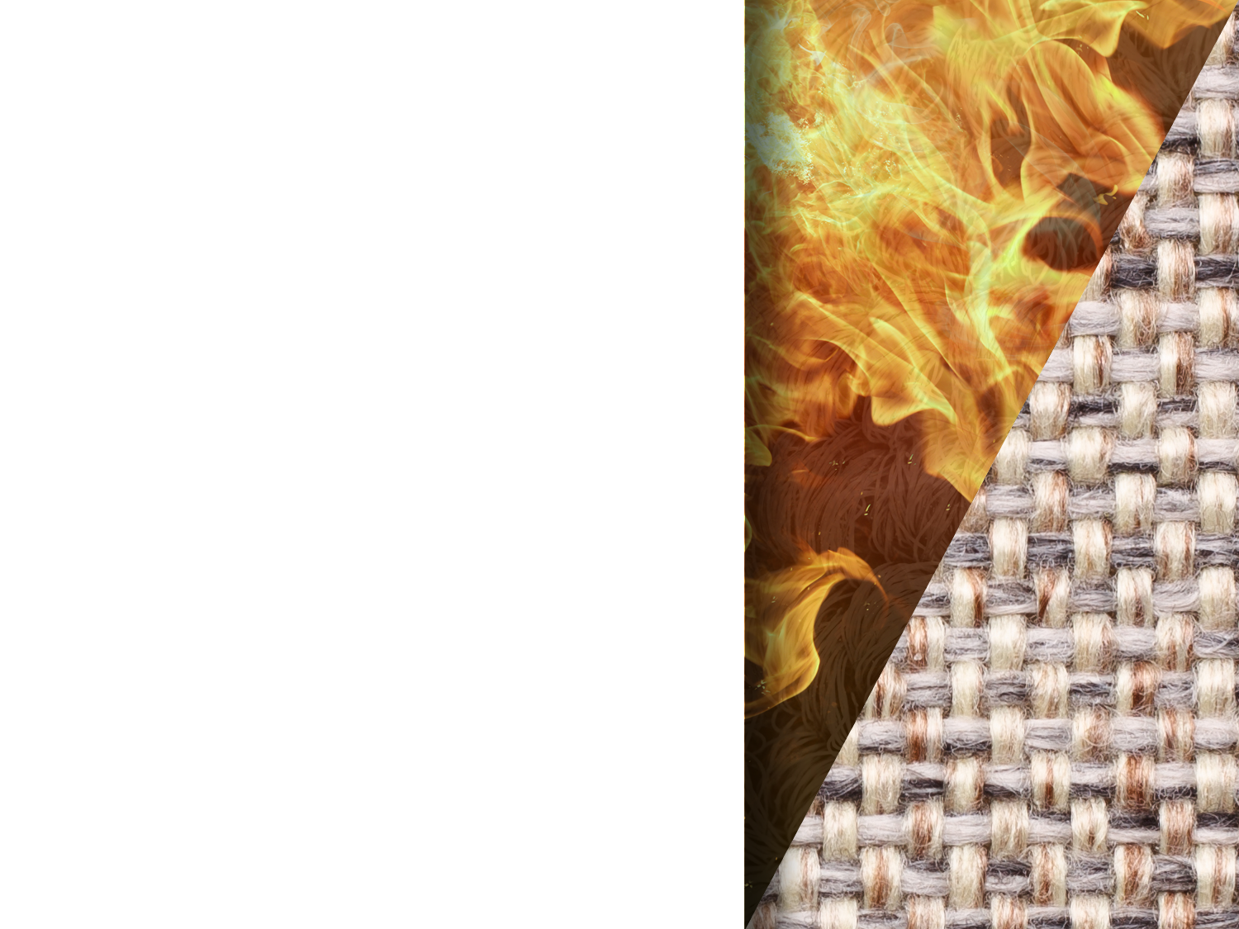
Decreased Escape Times
  Combustion behavior between synthetic and natural materials are different
  Synthetic materials:
  Ignite and burn faster than natural materials used 40 years ago
  Generate higher heat and smoke release rates than the natural materials

Slide 16
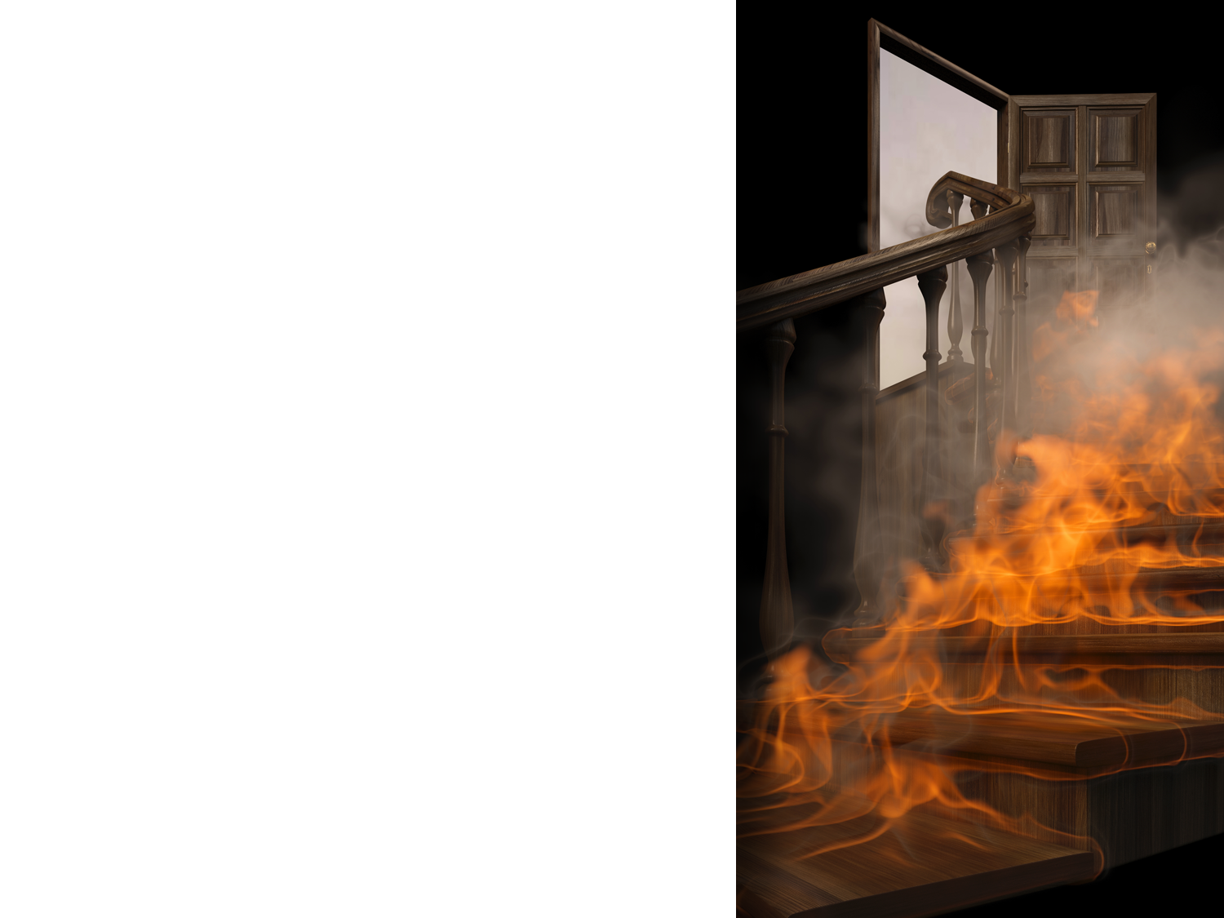
Decreased Escape Times
The window of available safe egress time (ASET) in flaming fires has decreased:
  1975: 17 minutes of ASET
  2007: 3 minutes of ASET
  The average ASET time for smoldering fires in the 1975 and 2007 tests were similar.
  Current smoke detection technologies still provided enough escape time in most fire scenarios
Source:
  Performance of Home Smoke Alarms Analysis of the Response of Several Available Technologies in Residential Fire Settings (Dunes II) Richard W. Bukowski et al (February 2008)

Slide 17
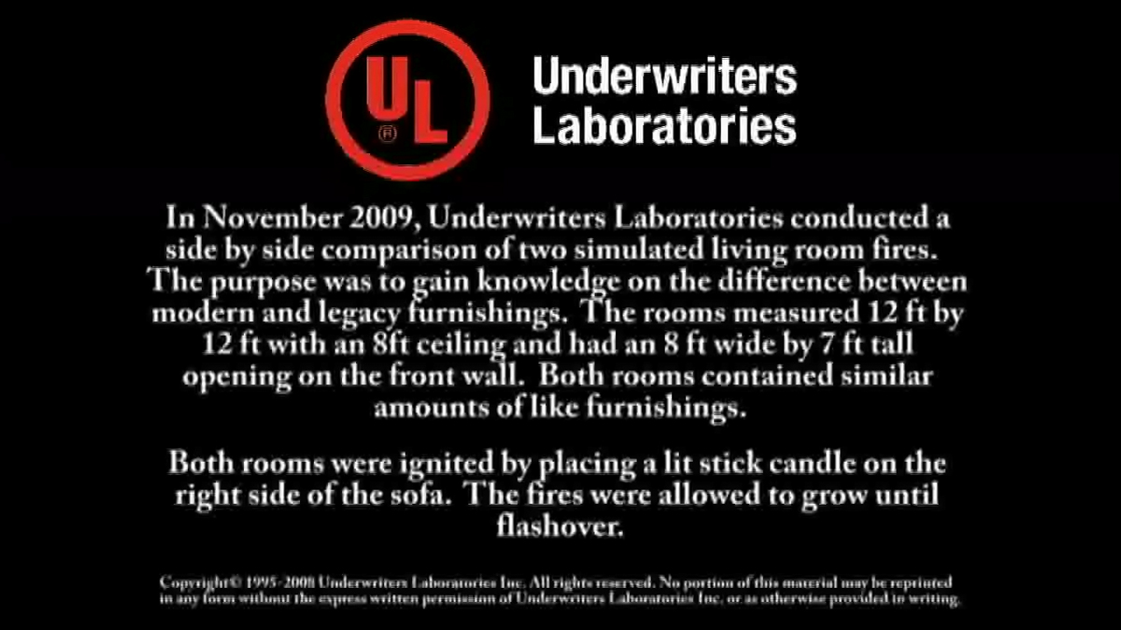
Comparison of Legacy and Modern Room Furnishing Fires
http://www.youtube.com/watch?v=aDNPhq5ggoE
Notes:
Comparison of legacy and modern room furnishing fires:

Slide 18
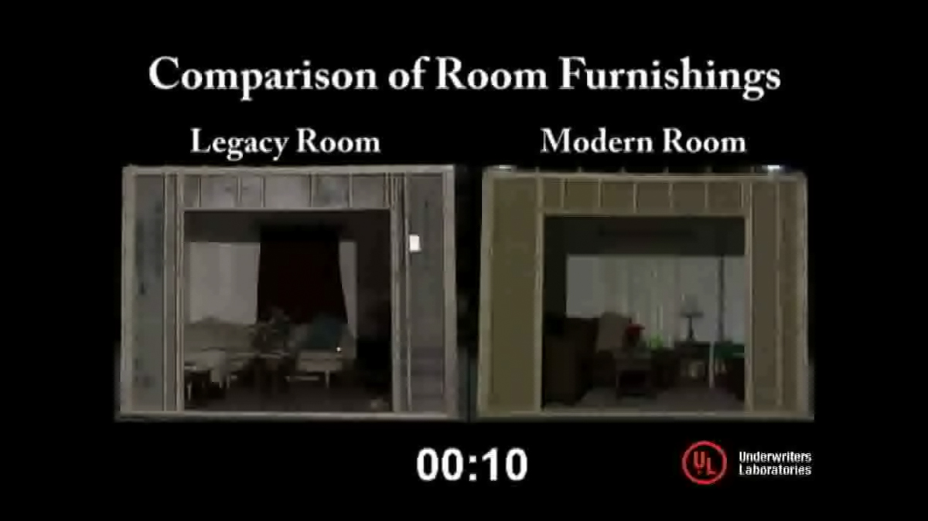
Comparison of Legacy and Modern Room Furnishing Fires
Notes:
Comparison of legacy and modern room furnishing fires:

Slide 19
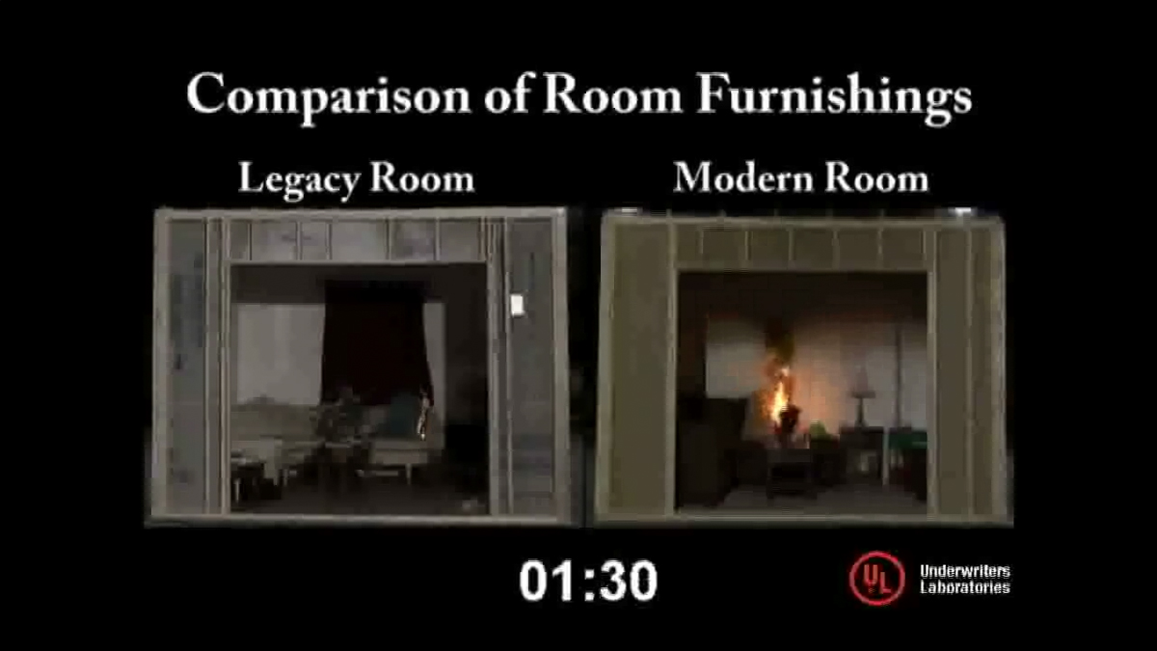
Comparison of Legacy and Modern Room Furnishing Fires
Notes:
Comparison of legacy and modern room furnishing fires:

Slide 20
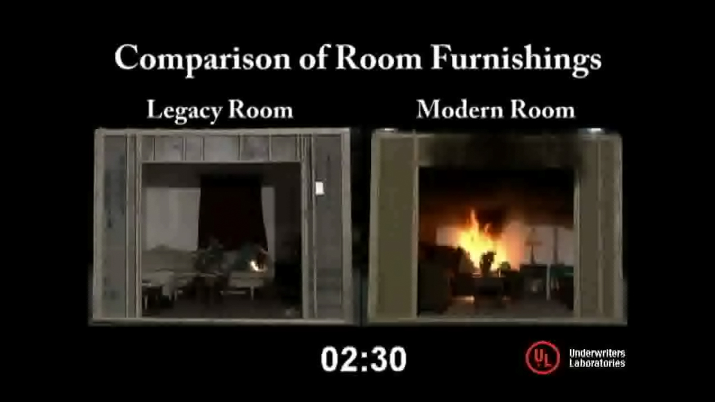
Comparison of Legacy and Modern Room Furnishing Fires
Notes:
Comparison of legacy and modern room furnishing fires:

Slide 21
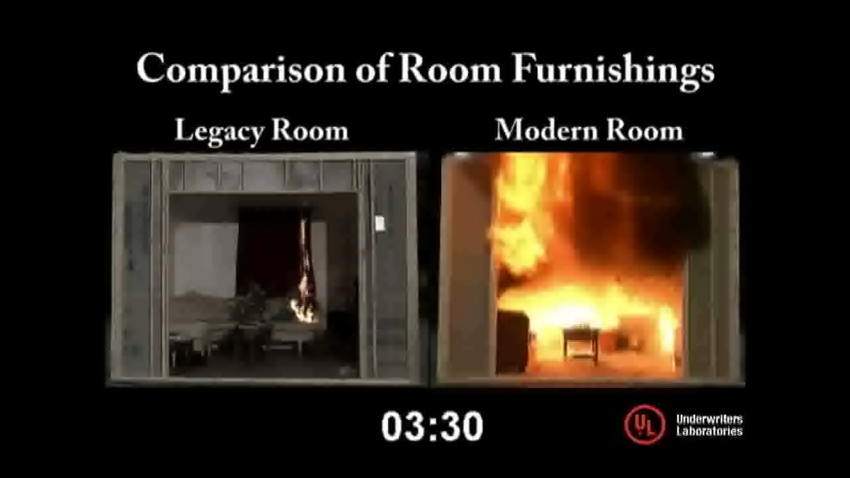
Comparison of Legacy and Modern Room Furnishing Fires
Notes:
Comparison of legacy and modern room furnishing fires:

Slide 22
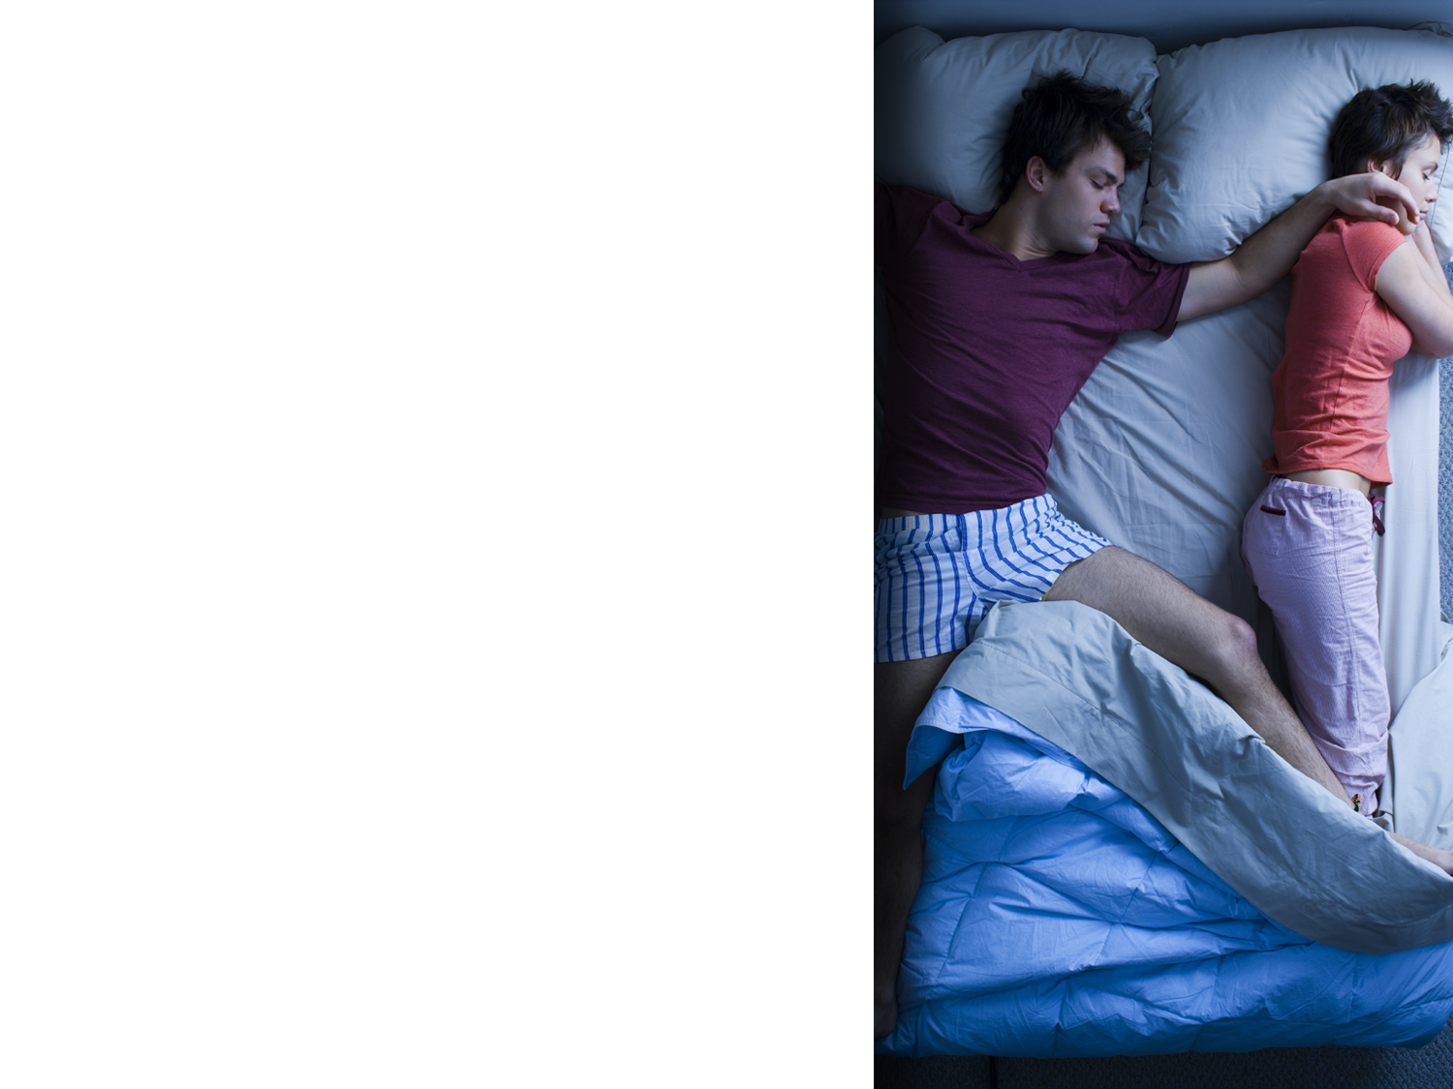
Waking Effectiveness
Fifty percent of civilian fire fatalities in residential buildings occur between the hours of 10 p.m. and 6 a.m.⁵
  Most unimpaired adults normally awaken quickly to the standard audible fire alarm signal⁶
  Most fire alarm horns produce a
  2 - 4 KHz audible alarm signal
  Most integral smoke alarm sounders produce a 3 KHz audible alarm signal
Source:
  USFA, Civilian Fire Fatalities in Residential Buildings 2008-2010 Report
  Awakening of Sleeping People – a Decade of Research, Ian Thomas and Dorothy Bruck July 2008

Slide 23
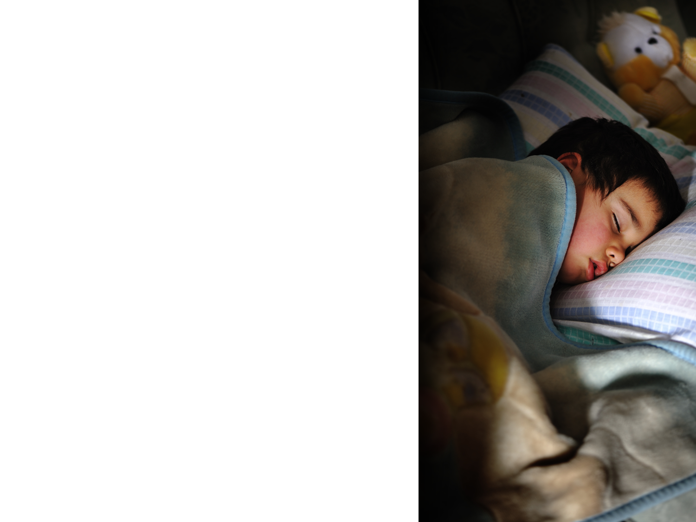
Waking Effectiveness
  There are many people at risk of not waking up by the standard audible alarm signal:
  School-Age Children: Thirteen percent of civilian fire fatalities in residential buildings were under the age of 10⁵
  The Elderly: Forty-four percent of civilian fatalities in residential building fires are between the ages of 40 and 69⁵
  People with Hearing Loss: More than 34.5 million people in the US are hard of hearing⁷
Source:
  USFA, Civilian Fire Fatalities in Residential Buildings 2008-2010 Report
  Waking Effectiveness of alarms for adults who are hard of hearing, NFPA Dorothy Bruck, Ian Thomas June 2007

Slide 24
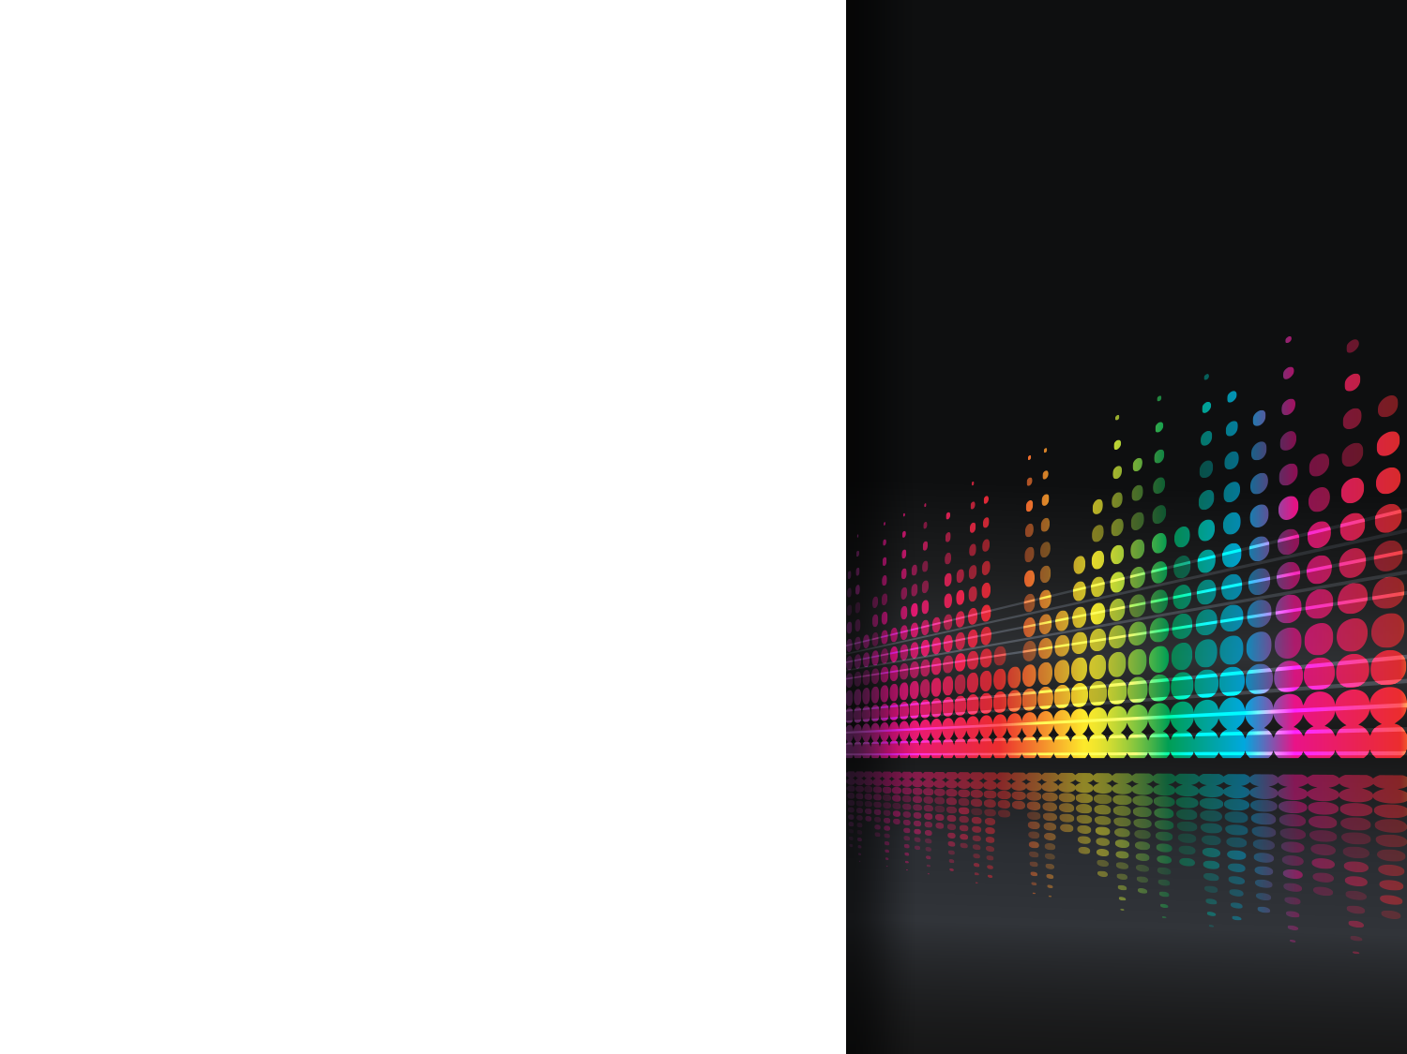
Waking Effectiveness
  The low frequency signal with a fundamental frequency of 520 Hz is most effective in waking most of the participants⁶
  The low frequency signal is 6 to 10 times more effective at waking children and young adults than the standard 3 KHz audible fire alarm signal⁶
  In adults with hearing loss, the low frequency signal is more than six times as effective than the 3 KHz signal and more effective than the bed and pillow shakers⁶
  Strobe lights were found to have very poor waking effectiveness⁶

Slide 25
  Origin of Low Frequency Requirements

Slide 26
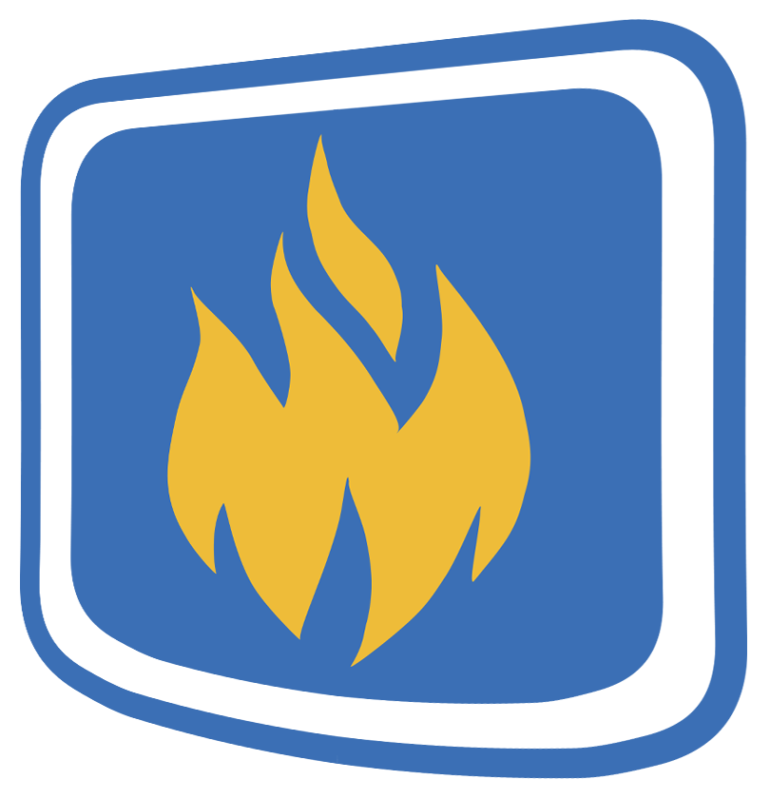
Origin of Low Frequency Requirements
In 2006, the Fire Protection Research Foundation (FPRF) conducted two research projects to study the effectiveness of the audible fire alarm signal of high risk groups.
The aim of the studies was to optimize the performance requirements to meet the needs of several high risk groups.
Source:
  Waking Effectiveness of alarms for adults who are hard of hearing, NFPA Dorothy Bruck, Ian Thomas June 2007
  Waking Effectiveness of alarms for the alcohol impaired , NFPA Dorothy Bruck, Ian Thomas June 2007

Slide 27
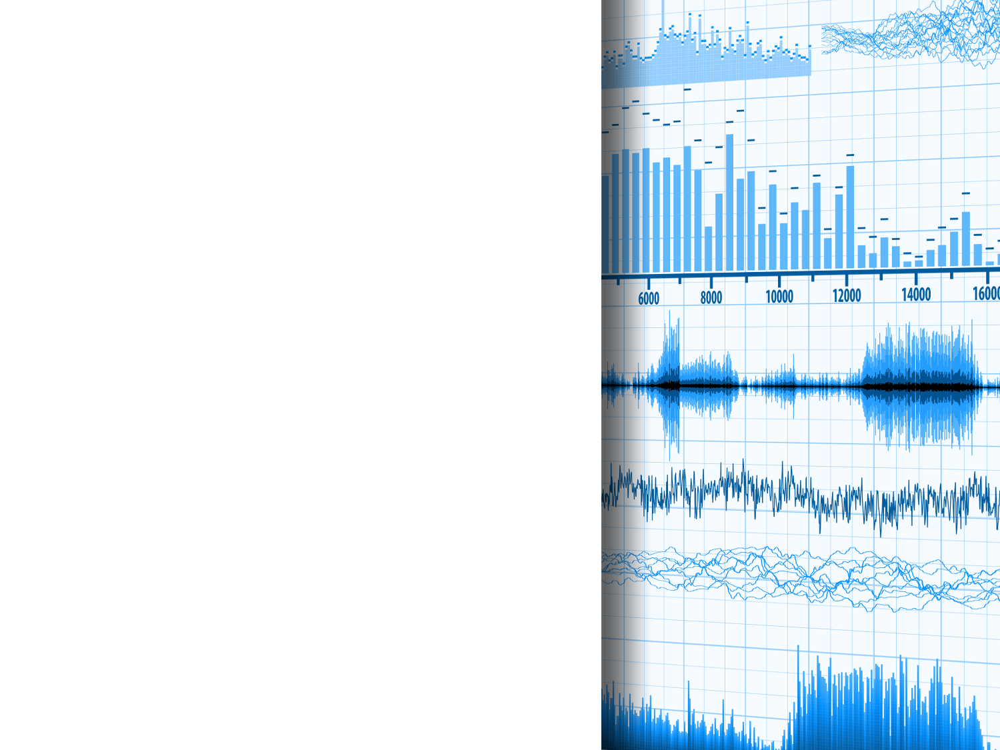
Origin of Low Frequency Requirements
The Studies tested six signals:
400 Hz square wave signal
520 Hz square wave signal
3 KHz pure tone (standard)
Bed shaker (under mattress)
Pillow shaker
Strobe light in T-3 pulse (modified)
Source:
  Waking Effectiveness of alarms for adults who are hard of hearing, NFPA Dorothy Bruck, Ian Thomas June 2007
  Waking Effectiveness of alarms for the alcohol impaired , NFPA Dorothy Bruck, Ian Thomas June 2007

Slide 28
Origin of Low Frequency Requirements
Conclusions:
  The low frequency signal with a fundamental frequency of 520 Hz is the most effective signal for awakening people who are hard of hearing
    Low frequency 520 Hz signal awoke 92%
    between 55 dBA and 75 dBA
    3 KHz pure tone signal awoke 56%
    between 55 dBa and 75 dBA
    The low frequency signal is superior to bed and pillow shakers and strobe lights
Source:
  Waking Effectiveness of alarms for adults who are hard of hearing, NFPA Dorothy Bruck, Ian Thomas June 2007
  Waking Effectiveness of alarms for the alcohol impaired , NFPA Dorothy Bruck, Ian Thomas June 2007

Slide 29
Standard Signal versus Low Frequency Signal
Standard
520 Hz
/
Notes:
Embed standard and low frequency audio files

Slide 30
Low Frequency Requirements: NFPA 72, NFPA 720, and UL

Slide 31
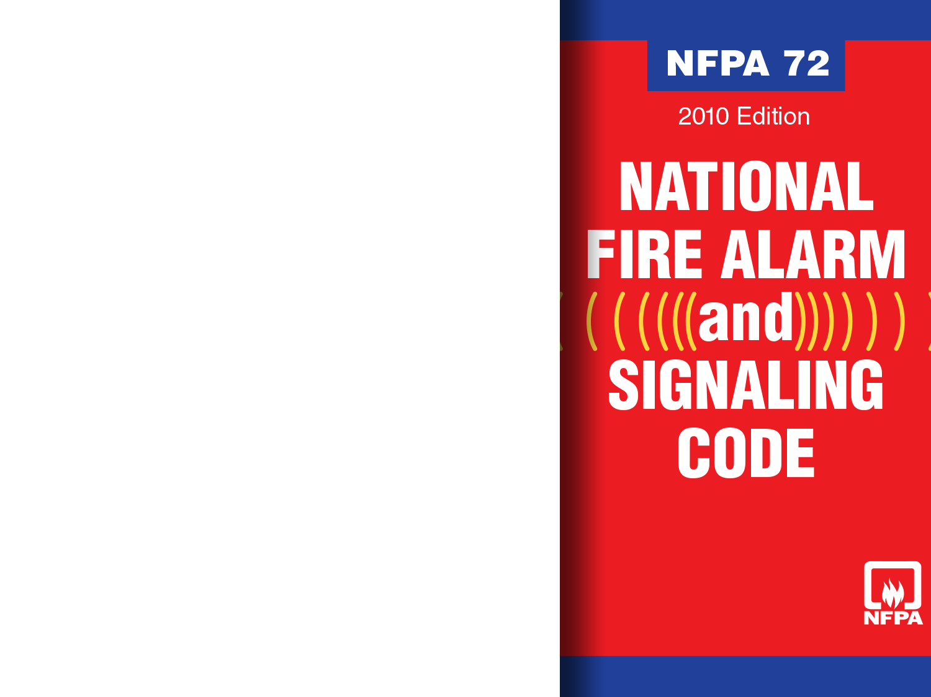
NFPA 72 Low Frequency Requirements
New low frequency requirements added to the 2010 edition of NFPA 72
  Chapter 18 – Notification Appliances
  Chapter 24 – Emergency Communications Systems (ECS)
  Chapter 29 – Single- and Multiple-Station Smoke Alarms and Household Fire Alarm Systems

Slide 32
NFPA 72 Low Frequency Requirements
2010 edition of NFPA 72
18.4.5.3* Effective January 1, 2014, where audible appliances are provided to produce signals for sleeping areas, they shall produce a low frequency alarm signal that complies with the following:
The alarm signal shall be a square wave or provide equivalent awakening ability.
The wave shall have a fundamental frequency of 520 Hz ± 10 percent.

Slide 33
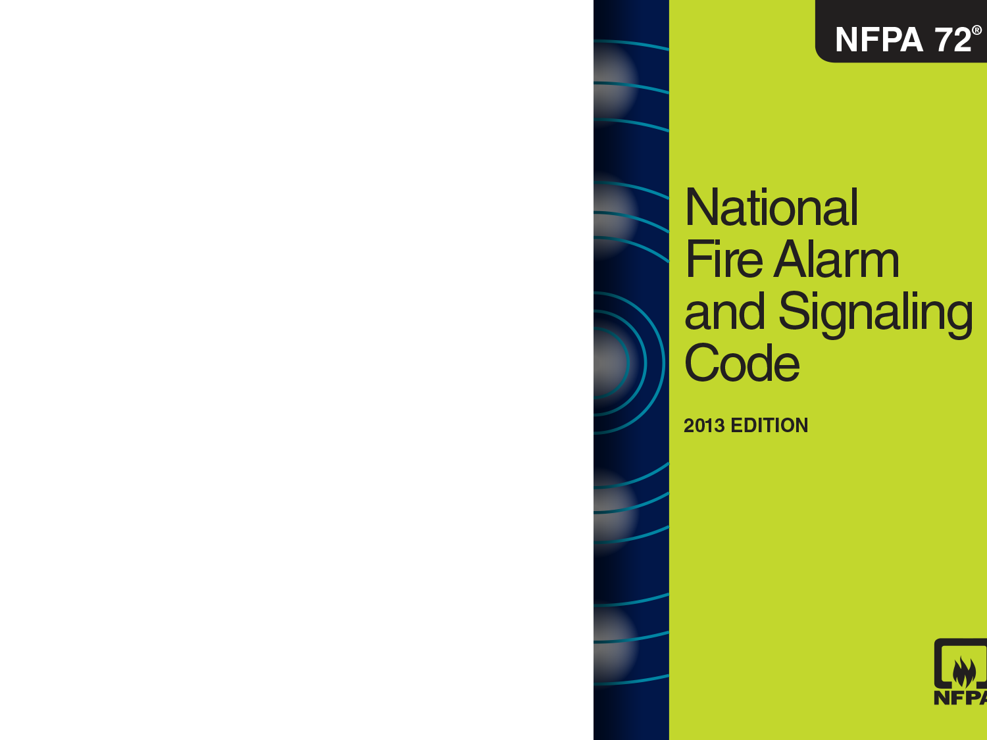
NFPA 72 Low Frequency Requirements
2013 edition of NFPA 72
The Chapter 18 Committee revised the wording to clearly state the low frequency requirement is to awaken people only
18.4.5.3* Effective January 1, 2014, audible appliances provided for the sleeping areas to awaken occupants shall produce a low frequency alarm signal that complies with the following:
The alarm signal shall be a square wave or provide equivalent awakening ability.
The wave shall have a fundamental frequency of 520 Hz ± 10 percent.

Slide 34
NFPA 72 Low Frequency Requirements
24.4.2.4.2* Except as specified in 24.4.2.4.3, in occupancies where sleeping accommodations are provided and the voice message is intended to communicate information to those who could be asleep, a low-frequency tone that complies with 18.4.5 shall be used.
24.4.2.4.3* In areas where sleeping accommodations are provided, but the voice communication system is used to communicate to occupants who are awake, the low-frequency tone shall not be required.

Slide 35
NFPA 72 Low Frequency Requirements
2010 edition of NFPA 72
29.3.8.1 Mild to Severe Hearing Loss. Notification appliances provided for those with mild to severe hearing loss shall comply with the following:
An audible notification appliance producing a low frequency alarm signal shall be installed in the following situations:
  *Where required by governing laws, codes or standards for people with hearing loss
  Where provided voluntarily for those with hearing loss

Slide 36
NFPA 72 Low Frequency Requirements
Section 29.3.6 unintentionally requires the low frequency signal in all sleeping areas where smoke alarms or household fire alarm systems are installed.
29.3.6 Audible fire alarm signals shall meet the performance requirements of 18.4.3 and 18.4.5
The Chapter 29 Committee never intended to require the low frequency signal in all sleeping areas.

Slide 37
NFPA 72 Low Frequency Requirements
A Tentative Interim Amendment (TIA) corrected oversight
TIA requires low frequency sounders only in sleeping spaces to awaken people with hearing loss by amending 29.3.6 to read as follows:
  29.3.6 All audible fire alarm signals installed shall meet the performance requirements of 18.4.3, 18.4.5.1, 18.4.5.2, and 29.3.8.
  The Chapter 29 Committee incorporated the TIA language into NFPA 72: 2013
  Both the 2010 and 2013 edition of the code require the low frequency signal only in sleeping spaces to awaken people with hearing loss.

Slide 38
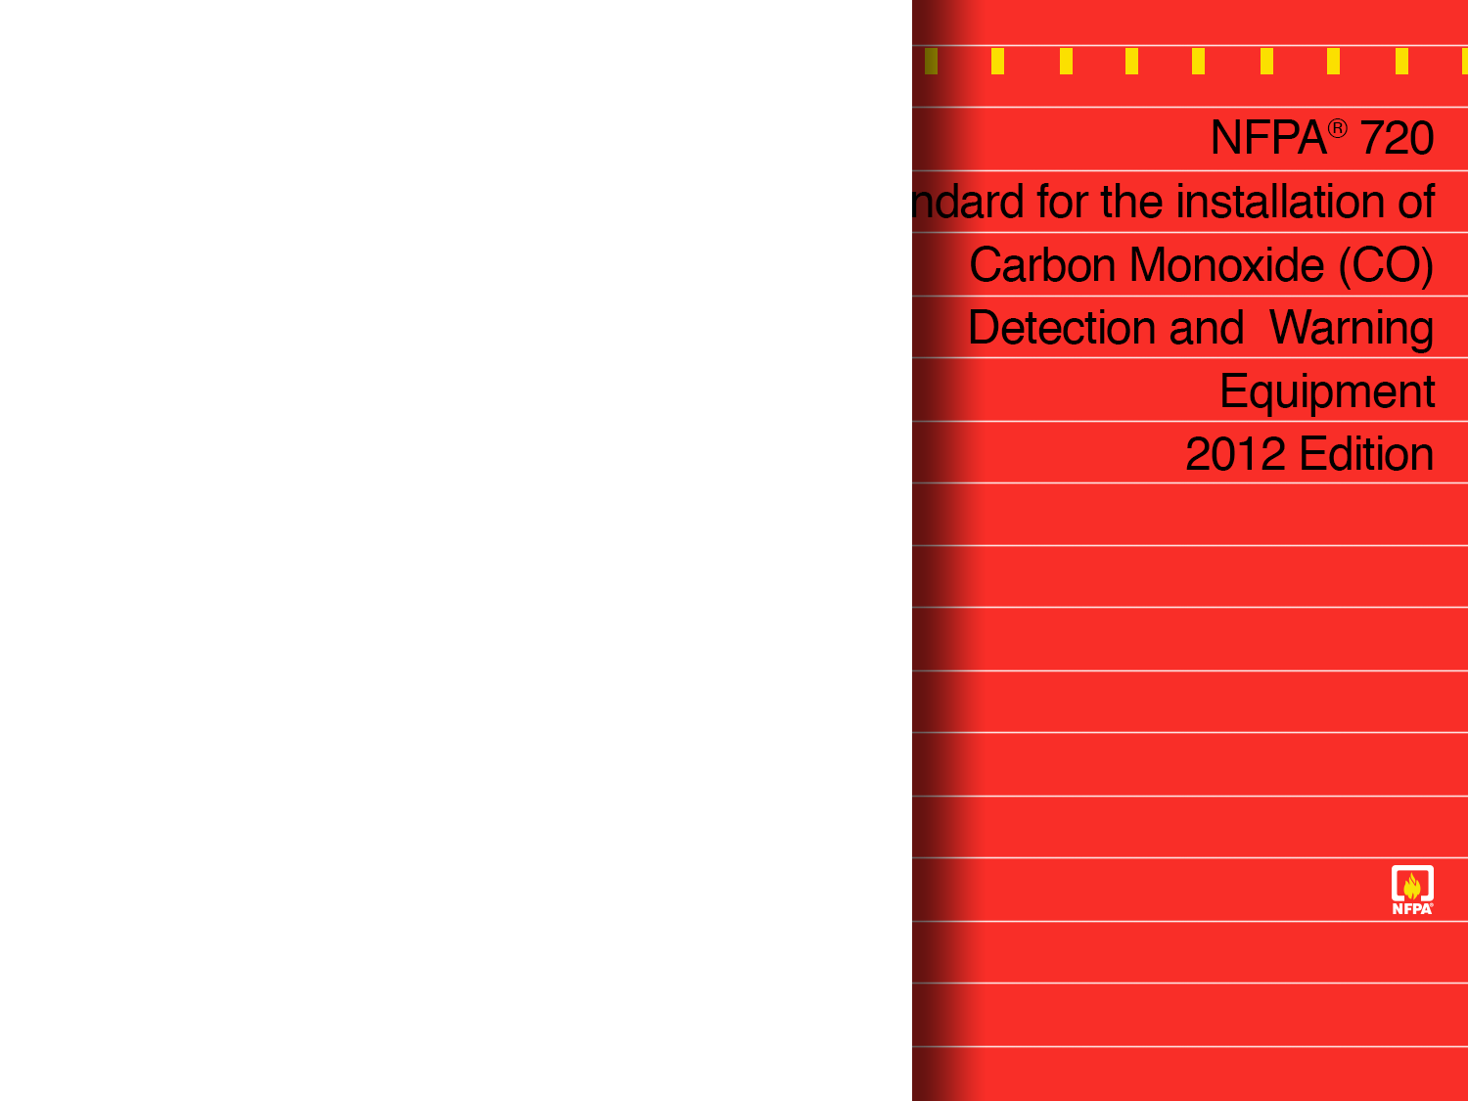
NFPA 720 Low Frequency Requirements
New low frequency requirements added to the 2012 edition of NFPA 720
6.4.4.3* Effective January 1, 2015, where audible appliances are provided to produce signals for sleeping areas, they shall produce a low frequency alarm signal that complies with the following:
The alarm signal shall be a square wave or provide equivalent awakening ability.
The wave shall have a fundamental frequency of 520 Hz ± 10 percent.

Slide 39
NFPA 720 Low Frequency Requirements
9.4.2.2.1.1 Mild to Severe Hearing Loss. Notification appliances provided for those with mild to severe hearing loss shall comply with the following:
An audible notification appliance producing a low frequency alarm signal shall be installed in the following situations:
  *Where required by governing laws, codes or standards for people with hearing loss
  Where provided voluntarily for those with hearing loss

Slide 40

UL Low Frequency Requirements
New low frequency test protocols
added to product safety standards:
ANSI/UL 464, Standard for Safety Audible Signal Appliances
  A low frequency notification
  appliance complying with
  section 24.1, shall be marked
  “Low Frequency Alarm or Low Frequency Sounder”
ANSI/UL 217, Single and
Multiple Station Smoke Alarms
  A low frequency alarm complying
  with Section 65, Audibility Test, shall
  be marked “Low Frequency Alarm”

Slide 41
  Group R-1 and R-2 Applications

Slide 42
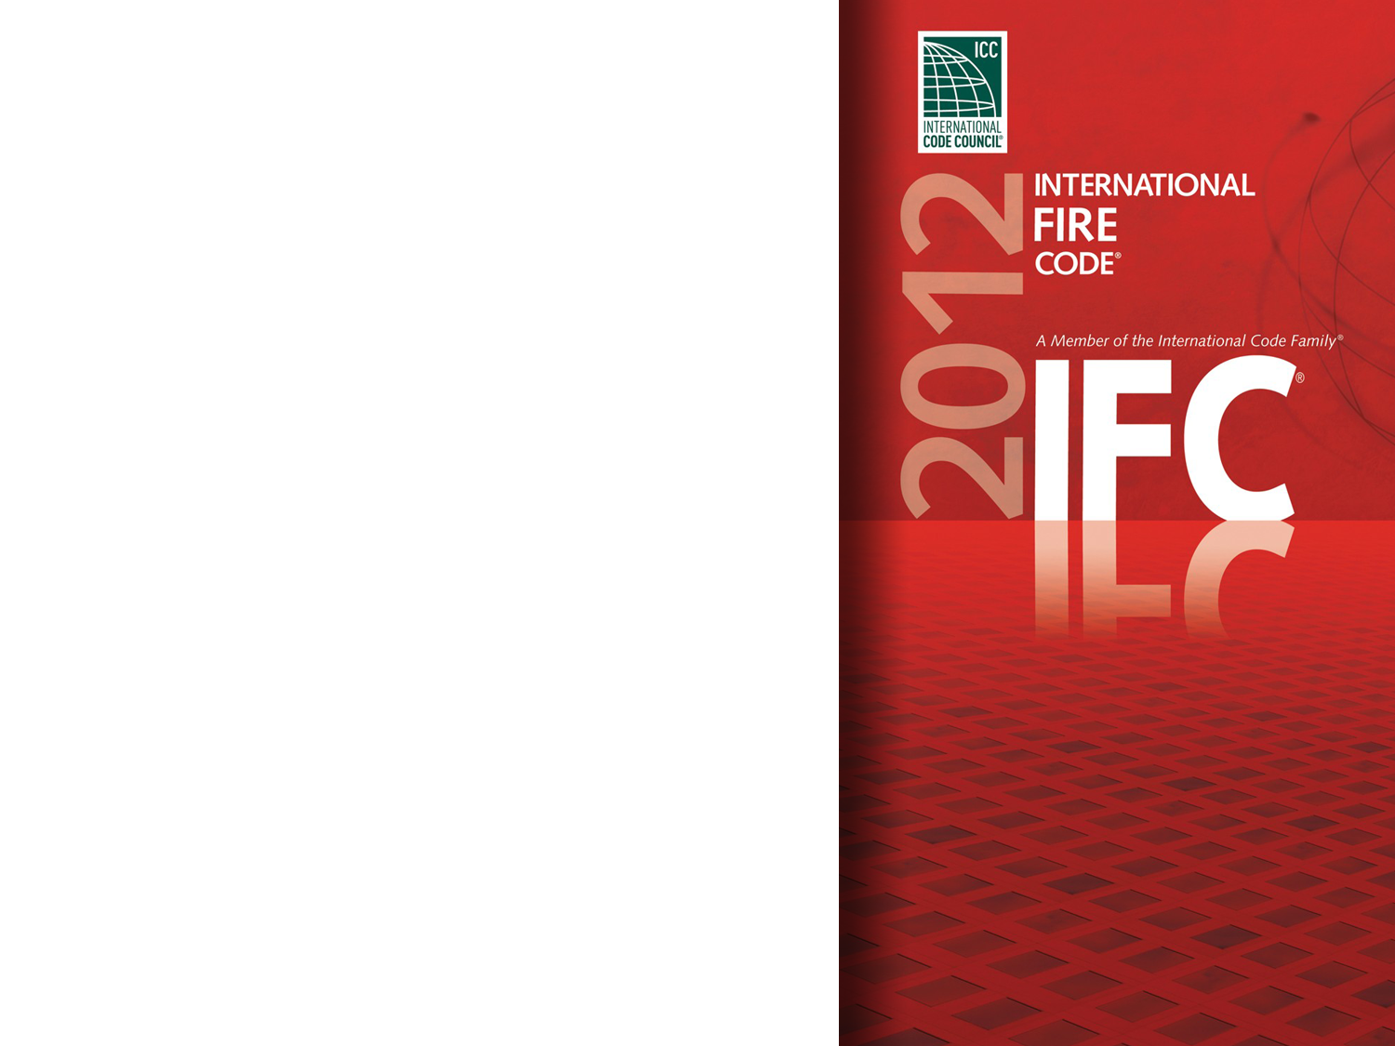
Required in Certain Group R Occup.
2012 IFC/IBC indirectly requires a low frequency signal in certain Group-R occupancies
907.2 Where required, an approved fire alarm system installed in accordance with the provisions of this code and NFPA 72 shall be provided in new buildings and structures and provide occupant notification in accordance with Section 907.5
  907.5 A fire alarm system shall annunciate at the fire alarm control unit and shall initiate occupant notification upon activation

Slide 43
Required in Certain Group R Occup.
2010 NFPA 72 is referenced in
  2012 IFC Chapter 80
  2012 IBC Chapter 35
18.4.5.3* Effective January 1, 2014, audible appliances provided for the sleeping areas to awaken occupants shall produce a low frequency alarm signal

Slide 44
Required in Certain Group R Occup.
Group R-1 Hotels and motels
907.2.8.1 A manual fire alarm system that activates the occupant notification system
Exceptions:
A manual fire alarm system is not required in buildings not more than two stories in height where all individual sleeping units have an exit directly to a public way, egress court, or yard.
Permits the fire alarm system to be activated by a sprinkler system and provide occupant notification

Slide 45
Required in Certain Group R Occup.
Group R-2 college and universities
907.2.9.2 An automatic smoke detection system that activates the occupant notification system

Slide 46
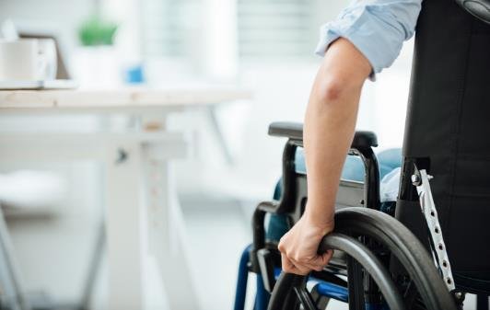
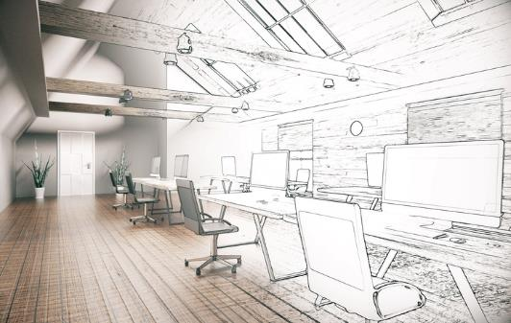

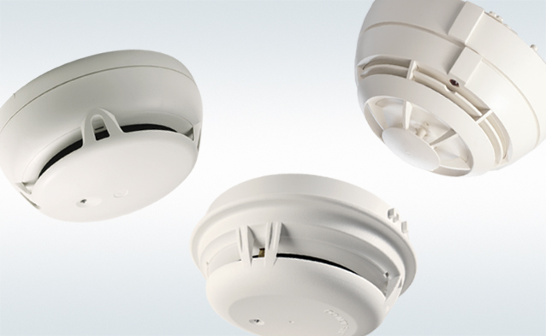
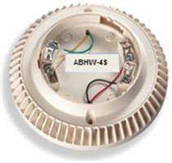
IBC-IFC Code Changes
Smoke Detection=
Smoke Alarms
520 Hz Audible Base
Positive Financial Impact
907.2.10.7 Smoke detection system. Smoke detectors listed in accordance with UL 268 and provided as part of the building fire alarm system shall be an acceptable alternative to single- and multiple-station smoke alarms
and shall comply with the following :
18.4.5.3* Audible appliances provided for the sleeping areas to awaken occupants shall produce a low frequency alarm signal
that complies with the following:
(1) The alarm signal shall be a square wave or provide equivalent awakening ability.
(2) The waveform shall have a fundamental frequency of 520 Hz ± 10 percent.
Many hotel chains have set this standard, real value in dorms and retrofits.

Slide 47
Industry Affairs Webinar Series 2018
Dan Finnegan
Manager of Industry Affairs
Siemens Building Technologies
Phone: 630.240.4328
E-mail:
daniel.finnegan@siemens.com
siemens.com

